Slide 1
Build your Culture through Employee Engagement
Leadership, Mission, Alignment, Clarity and People
Notes:
Intro myself-Brian George- Cutco Corp for over 20 years- LC Alum-2013- LC VP Board- Board Chair for SA- Alderman for the City of Olean- Co-Chair of this event today.
There are things you believe and things you know and you will stand firm on with every thing you have.

Slide 2
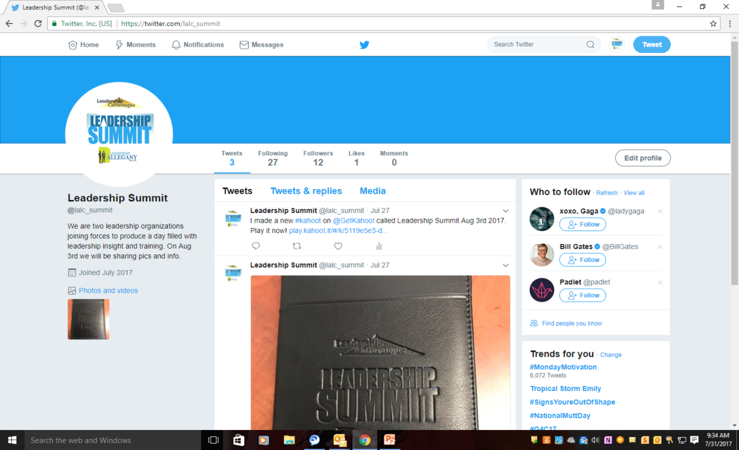
Social Media
Twitter page
@lalc_summit
#lalcsummit
Link for survey-playkahoot
Notes:
Reminder on Social Media page and survey

Slide 3
Networking
If you are setting with a person that you sat with previously today, please move and introduce yourself!
Notes:
Please to get the most out of the experience- if its out of your comfort zone I understand. Networking is a good thing….

Slide 4
Exercise for us?
Ideas from everyone on how to improve the Leadership Summit for next year?
Takeaways
Is everyone in your organization on a level playing field or is there input valued- are your rooms Hierarchal or flat
Do people with positions get there voices heard first and do they look for others to be connected to decision
How do people feel about there roles
Notes:
Lollipop experiment
Give every 3rd or 4th person a lollipop
Describe them in very flattering terms
Describe the folks with out as not as good as people with lollipops
Ask for input on how to improve the Summit
Use only the people with lollipops ideas and again say how great they are
Ask for others opinions but put them down
Takeaways- People with position or leadership roles and do you put there ideas first or do you look to collaborate with everyone equally

Slide 5
Important Question?
Notes:
I believe Leadership is a choice and how you lead is an even bigger decision. So when your feet hit the ground in the morning, what kind of impact do you want to have?

Slide 6
The Story-Bob Chapman
Notes:
Tell’s a story for how and what we want to achieve….

Slide 7
Involvement vs. Engagement
Employee Involvement definition- Condition of being involved with or participating in something
Employee Engagement definition- Feel passionate about their jobs, are committed to the organization, and put genuine effort into their work

Slide 8
The Research- Data for Engaged and Disengaged
Gallup- 33% of U.S. employees engaged in 2015
Monthly averages largely consistent
Engagement flat since 2000
Moreover, they found that only 33% of U.S. employees are engaged in their job, and slightly more than half of employees (51%) say they are actively looking for a new job or watching for openings.
Barry Wehmiller CEO Bob Chapkman- Because seven out of eight people believe the company they work for does not care about them.

Slide 9
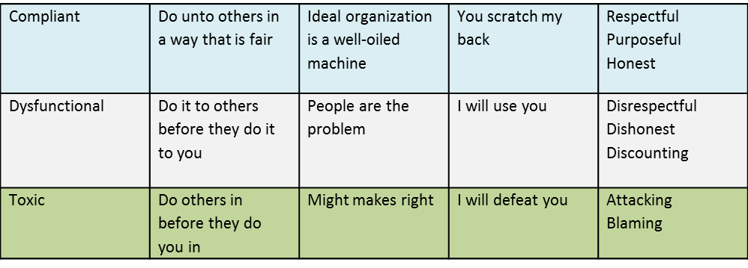
Cultural Chasm

Slide 10
Engagement Continuum 80/20
Resistant
Reluctant
Compliant
Committed
Compelled
Exist
Notes:
Focus on the 80 and be sure to generate momentum around that.

Slide 11
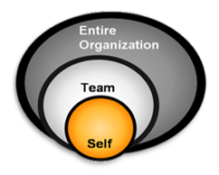
Three Circle Approach
Vison and Purpose- Alignment with our work
What are we doing?
Why are we doing it?
Where do I fit in?
Mission Statement- that means something
To create a truly exceptional experience for our people
Through leading a People 1st culture

Slide 12
Mission of your organization
Notes:
Read the exceptional experience handout

Slide 13
The Brand

Slide 14
Leadership Team Values
People First Culture
1. Involve and engage people
2. Align and educate to our opportunities
3. Leadership committed to do the right thing

Slide 15
Powerful Question
What do you think?

Slide 16
People First Description of Employee Engagement
A focus on nurturing the right condition for people to do and give their best each day.
Clarity and commitment to the organizations goals and values
Being activated to contribute to its success
People having an enhanced sense of well-being

Slide 17
Authentic Experience
Tell the story of employee/personal engagement
Notes:
Talk about Tom Sutley…

Slide 18
Methods of Influence/Motivation

Slide 19
Simon Sinek on David Marquet

Slide 20
The “Why”

Slide 21
Empowerment Formula

Slide 22
Leadership Focus

Slide 23
Personal Question?
The time where you become an adult, is when you realize it isn’t about you.
Ken Blanchard
The Servant Leader

Slide 24
Take the First Step

Slide 25
Guiding principles to consider
Please consider these statements?
Begin every day with a focus on the lives you touch.
Embrace leadership practices that send people home each day safe, healthy and fulfilled.
Align all actions to an inspirational vision of a better future.
Look for the goodness in people, and recognize and celebrate it daily.
Lead with a clear sense of grounded optimism.
Always measure success by the way you touch the lives of people
Be intentional about this…

Slide 26
I Appreciate your time!!

