Slide 1
Winning the War Within
How Checking Your Ego and Taking Ownership Can Make You A Better Leader

Slide 2
Here’s What We’ll Discuss
What is ego?
Why is it bad?
Can it be good?
What does it mean to “check your ego?”
What does it mean to take ownership?
How do ego and ownership tie together?

Slide 3
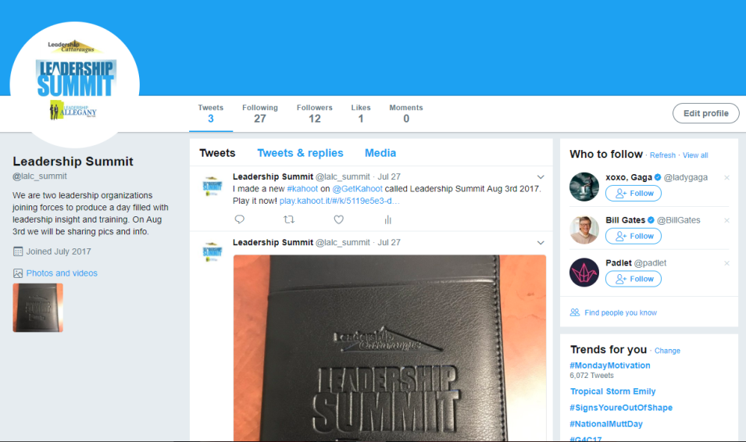
Social Media
Twitter
Follow the summit @lalc_summit
Use #lalcsummit
Link for survey-playkahoot

Slide 4
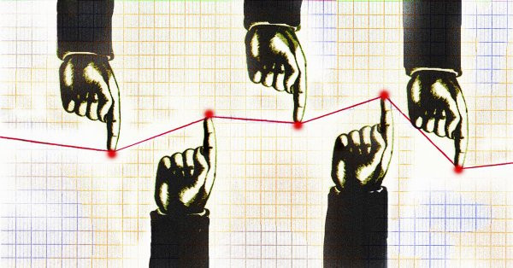
Networking
If you are sitting with a person that you sat with previously today, please move and introduce yourself!

Slide 5
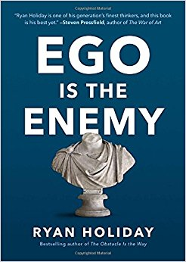
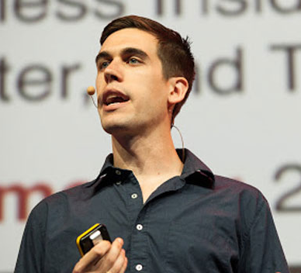
Ego is the Enemy

Slide 6
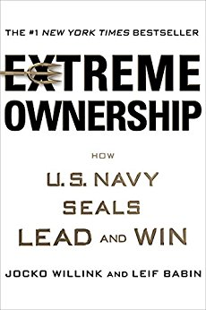
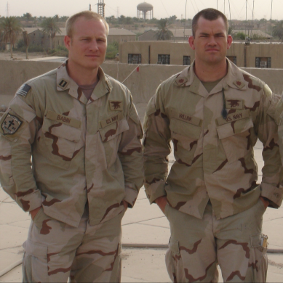
Extreme Ownership- How U.S. Navy SEALs Lead and Win

Slide 7
What is ego?
What first comes to our mind?
Positive or negative?
Is it complimentary to say someone has a big ego?
What do you think?

Slide 8
What is ego?
“the ego we see most commonly goes by a more casual definition: an unhealthy belief in our own importance. Arrogance. Self-centered ambition.”
“It’s the petulant child inside every person, the one that chooses getting his or her way over anything or anyone else. The need to be better than, more than, recognized for, far past any reasonable utility – that’s ego. It’s the sense of superiority and certainty that exceeds the bounds of confidence and talent.”

Slide 9
What is ego?
Getting caught in traffic
Roundabouts are backed up
Someone cut you off
A driver in the roundabout stops to let someone in
Why are you mad?
Ego
Self-importance
Arrogance

Slide 10
What is ego?
The unwillingness to give up responsibilities
Despite lack of time, resources, knowledge, or ability
What are the thoughts that go through your mind?
What will my leaders think?
How will this hurt my reputation?
How will this affect my confidence?
This is ego, making it all about yourself
Consider how it will affect your team
How will it affect those closest to you
How does it affect the mission

Slide 11
What is ego?
In Extreme Ownership, Jocko Willink gives an example of a SEAL platoon commander who is nervous about the arrival of a new unit with superiorly trained Iraqi soldiers as opposed to the Iraqis under his command. He is afraid they will out-perform his unit. Jocko’s response was:
“If they outperform your team and take your mission, good. We will find you another one. Our mission is to defeat this insurgency. We can’t let our egos take precedence over doing what is best to accomplish that.”
Jocko points out to this commander that he needs to put the mission first and not be concerned about his reputation, his ego.

Slide 12
Why is ego bad?
Ego causes you to focus on yourself instead of the overall mission
It prevents you from asking for help when you need it
It can your decisions in order to preserve your own image and reputation, as opposed to doing what is right

Slide 13
Can ego be good?
To some, ego is just a synonym for some more positively viewed attributes:
Drive
Ambition
Hunger
Passion.
These are certainly good things to be. And truthfully I think it would be pretty much impossible to find a successful person who didn’t have ego driving and pushing them to some degree.

Slide 14
Can ego be good?
In “Ego is the Enemy,” Holiday eludes to this while carefully noting the potential danger:
“… for people with ambitions, talents, drives, and potential to fulfill, ego comes with the territory. Precisely what makes us promising as thinkers, doers, creatives, and entrepreneurs, what drives us to the top of those fields, makes us vulnerable to this darker side of the psyche.”

Slide 15
Checking your ego
This is not easy
Ego is deceptive.
It’s difficult to notice when it’s your own ego that’s the issue
We can see ego easily in others but it’s much more challenging to see it within ourselves.

Slide 16
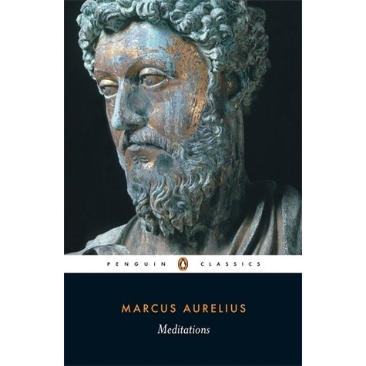
Checking your ego
Detachment
Reflection
Meditations by Marcus Aurelius

Slide 17
Taking ownership
In Extreme Ownership, Jocko outlines a situation in Ramadi, Iraq were a friendly Iraqi soldier was killed and a SEAL was wounded.
A miscommunication and breakdowns on multiple levels had caused a “blue-on-blue,” or more commonly known as “friendly fire.”
As the SEAL commander in charge Jocko knew he would have to explain to higher command what had happened and that they would be looking for someone to blame.

Slide 18
Taking ownership
In preparing for the debrief Jocko looked at all of the individual points of error and realized it boiled down to one thing:
As the commander he was the one to blame.
Despite the heavy blow to his ego he knew it was the right thing to do.
He also felt his reputation had suffered a hit that day.

Slide 19
Taking ownership

Slide 20
Taking ownership
Opposite effect on his reputation.
It increased the trust his commanding officers had in him, as well as the trust his team had.
As a leader in any situation you are ultimately responsible for everything. Whether in your work life or personal life it begins and ends with you.

Slide 21
Taking ownership
And make no mistake; even if you are at the “bottom” of the chain of command, or the corporate ladder, or whatever you want to refer to it as, you still need to own the situation.
Life is full of examples where we should take ownership but frequently don’t because it’s easier to pass the blame.
If we pass the blame we can save our egos. We can even save our reputations, right?

Slide 22
Ownership Activity
5 scenarios given
What would your response be if you were focused on passing the blame?
What would your response be if you’re taking ownership?
What are your thoughts on the difference between the two?

Slide 23
Ego and Ownership
What ego is, how it can be helpful, but more frequently how it create
Taking ownership and how it can help us keep our ego in check.
Taking ownership over situations when they go wrong, takes humility and practice, but earns you respect.
Understanding of how deceitful our egos can be and how detrimental to true success ego is.
Discussion on ownership has provided you with a tool to overcome ego and to achieve your true potential as a leader

